Slide 1
Cost

Slide 2
Learning Objectives:
Nature & Type of Costs
Explicit Cost & Economic Cost
Fixed & Variable Cost
Sunk Cost
Marginal Cost
Short Run Cost Functions
Long Run Cost Functions
Economies and diseconomies of scale

Slide 3
The Nature of Costs
Cost of Production:
Costs incurred on factor inputs
Explicit Costs:
Actual money spent in purchasing or hiring services of factor inputs
Accounting Costs
Economic Costs:
Implicit Costs: Cost of self-owned and self-employed resources
Alternative or Opportunity Costs: value of an input in its next best alternative use

Slide 4
Fixed costs:
Costs which do not change with change in the quantity of output. These costs exist whether production occurs or not.
Variable or Prime costs:
Costs which change with change in level of output
Cost of long-lived Assets during a period:
Traditional approach: depreciation
Economic approach: change in the market value from the beginning to the end of the period

Slide 5
Sunk Costs:
Expenditures that have been made in the past or that must be made as part of a contractual agreement. It should not be considered while taking decisions.
Marginal cost:
Change in total cost associated with a one-unit change in output
Incremental Costs:
Total additional cost of implementing a managerial decision

Slide 6
The Long Run and the Short Run
Long Run
Short Run
A time period where all factors of production, even the capital stock, can be varied.
A period of time where at least one factor is fixed, usually capital stock is fixed, and all others are variable.

Slide 7
Short-Run Cost Functions
Total Cost = TC = f(Q)
TC = TFC + TVC
Total Fixed Cost = TFC &
Total Variable Cost = TVC
Average Fixed Cost = AFC = TFC/Q
Average Variable Cost = AVC =TVC/Q
Average Total Cost = ATC = TC/Q
Average Total Cost = AFC + AVC
Marginal Cost = ΔTC/ΔQ = ΔTVC/ΔQ

Slide 8
Short-Run Cost Functions
Average Variable Cost
AVC = TVC = w L
Q Q
= w = w
Q/L AP_{L}
Marginal Cost
ΔTC/ΔQ = ΔTVC/ΔQ = Δ(w L)/ΔQ
= w = w
ΔQ/ΔL MP_{L}

Slide 9
Short-Run Cost Functions
Q
TFC
TVC
0
$60
$0
1
60
20
2
60
30
3
60
45
4
60
80
5
60
135

Slide 10
Short-Run Cost Functions
Q
TFC
TVC
TC
AFC
AVC
ATC
MC
0
$60
$0
$60
-
-
-
-
1
60
20
80
$60
$20
$80
$20
2
60
30
90
30
15
45
10
3
60
45
105
20
15
35
15
4
60
80
140
15
20
35
35
5
60
135
195
12
27
39
55

Slide 11
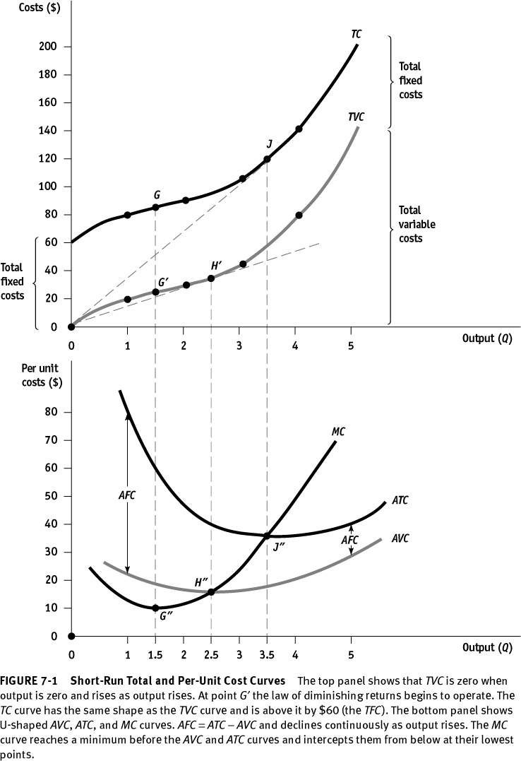

Slide 12
Cost
250
Total Cost Function
200
T C
150
T V C
100
T F C
50
0
Output
0
1
2
3
4
5
6
Cost
90
Per Unit Cost Function
80
70
60
M C
50
A C
40
30
A V C
20
10
0
Output
0
1
2
3
4
5
6

Slide 13
Long-Run Cost Curves
Long-Run Total Cost = LTC = f(Q)
Long-Run Average Cost = LAC = LTC/Q
Long-Run Marginal Cost = LMC = ΔLTC/ΔQ

Slide 14
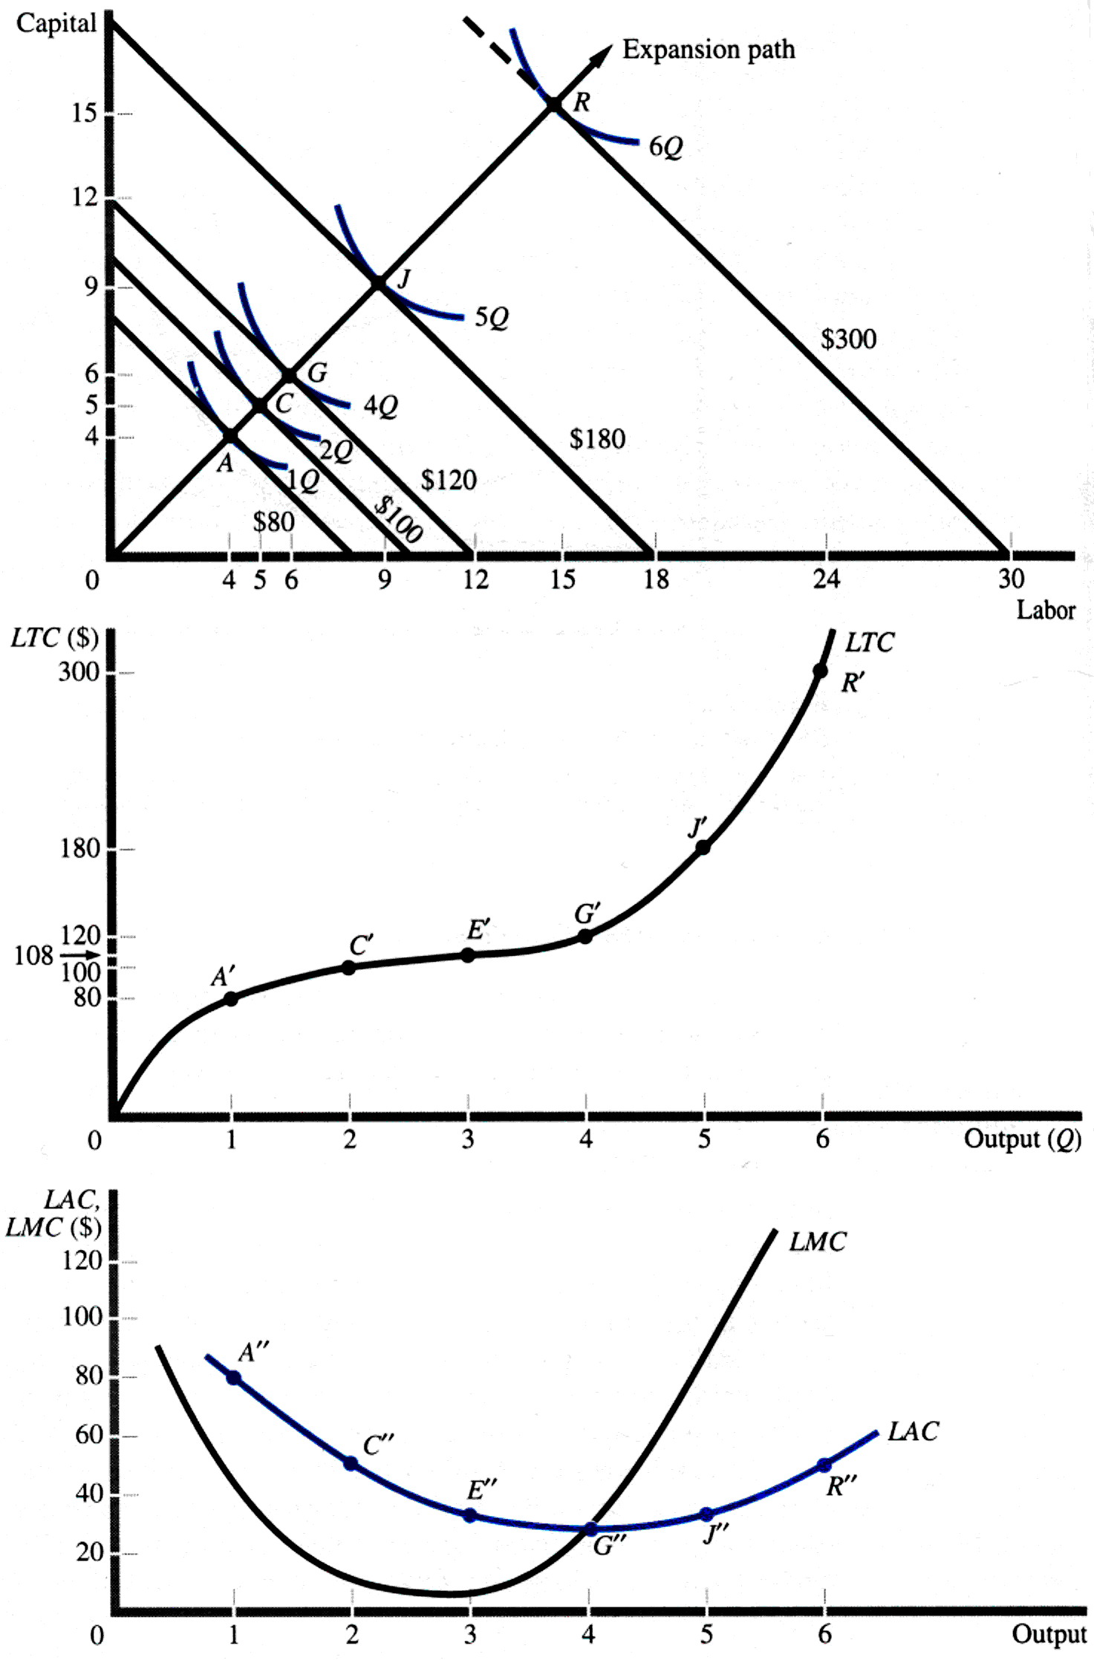
Derivation of Long-Run Cost Curves

Slide 15
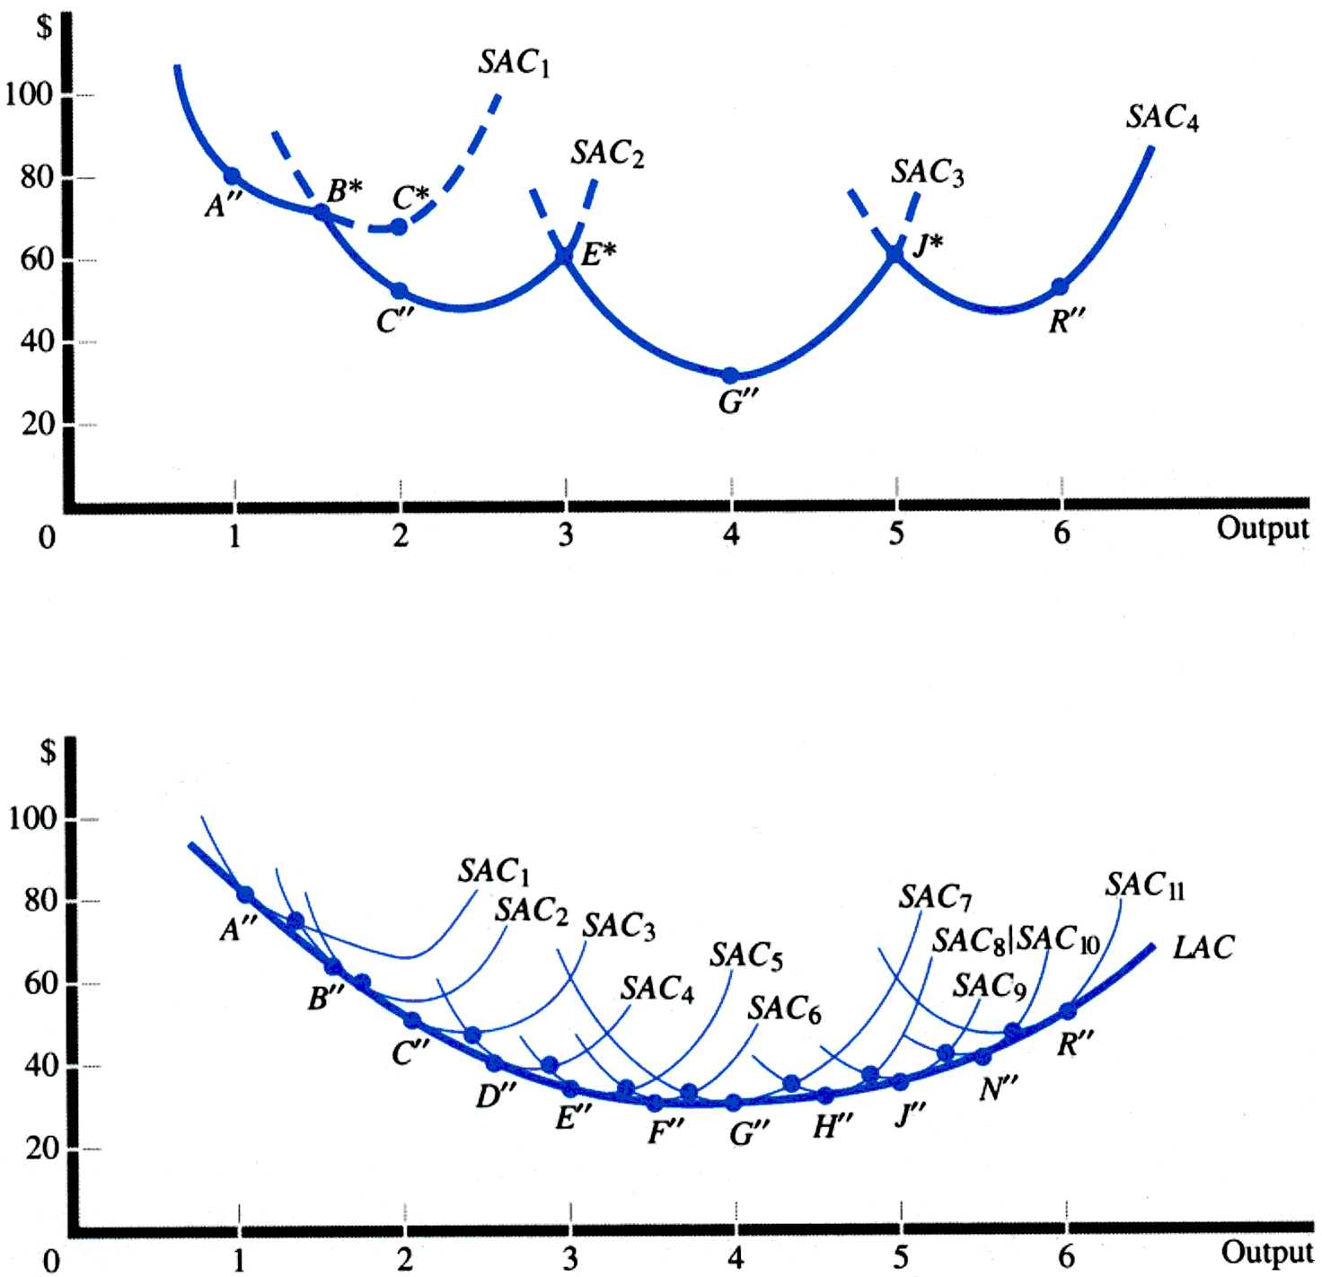
Relationship Between Long-Run and Short-Run Average Cost Curves
The long run average cost curve shows the lowest cost of producing each level of output when the firm can build the most appropriate plant to produce each level of output.

Slide 16
Relationship Between Long-Run and Short-Run Average Cost Curves

Slide 17
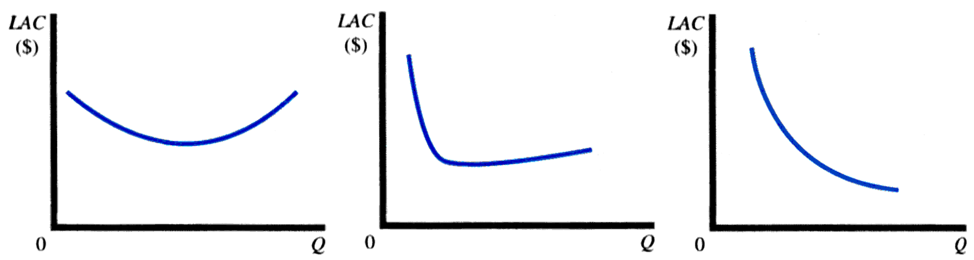
Possible Shapes of the LAC Curve

Slide 18
Economies of scale refer to the property whereby long-run average total cost falls as the quantity of output increases.
Diseconomies of scale refer to the property whereby long-run average total cost rises as the quantity of output increases.

Slide 19
Economies of Scale
(output grows proportionately faster than inputs)
Due to large plant
Due to large firm
Quantity discounts
Specialization
Funds raising
Indivisibility
Sales promotion
Productivity
Innovation
Equipment
Maintenance
Management
Technological forces/
Plant economies
Financial forces/
Firm economies

Slide 20
Diseconomies of Scale
Due to large plant
Due to large firm
Imperfection in
labor market
Coordination and
control
Transportation cost

Slide 21
Profit Contribution Analysis
Total Revenue = TR = (P)(Q)
Total Cost = TC = TFC + (AVC)(Q)
Profit = TR –TC
Profit = Π = PQ - [TFC + (AVC)(Q)]
Profit contribution = P- AVC
Q = TFC + Π
P - (AVC)
At Breakeven point,
TR = TC
Π = TR - TC = 0
Q_{BE} = TFC
(P - AVC)

Slide 22
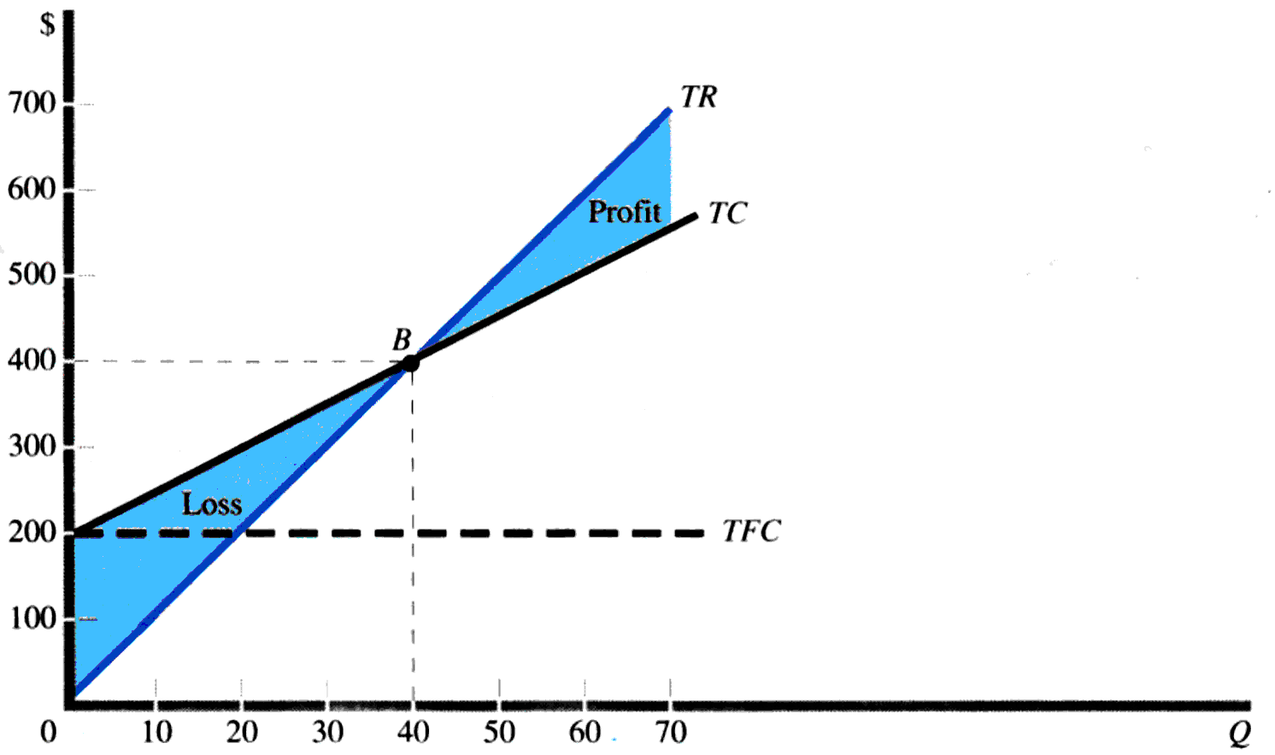
Linear Breakeven Analysis
P = 10
TFC = 200
AVC = 5
Shortcomings
Assumes constant prices
Assumes constant AVC
Firm produces a single product or a constant product mix of products

Slide 23
Example
MA Inc. specializes in the production and mail-order distribution of computer programs. The development and production costs (in $) are:
Development Costs:
Program Development 10000
Manual preparation and typesetting 3000
Advertising 10000
Distribution Costs/ unit.
Blank Disk 2
Loading Cost 0.5
Postage and Handling 1.25
Printing of manual 2.75
Price of one program with manual = $40
a). Determine breakeven no. of programs and TR at this volume.
b). If Profit target = $40,000, determine the unit and dollar volume of sales.
c). If price falls by 25%, determine the new breakeven unit and dollar volume.

Slide 24
Example
a). Determine breakeven no. of programs and TR at this volume.
Qe = 23000/ (40-6.5) = 686.6 units
TR at Qe = 40*686.6 = $27,464
Q = TFC + Π
P - (AVC)
b). If Profit target = $40,000, determine the unit and dollar volume of sales.
Q₄₀₀₀₀ = (23000+40000) / (40-6.50) = 1880.6 units
TR = $75, 224
c). If price falls by 25%, determine the new breakeven unit and dollar volume.
Qe = 978.7 units
TR = 30* 978.7 = $29,361

